Slide 1
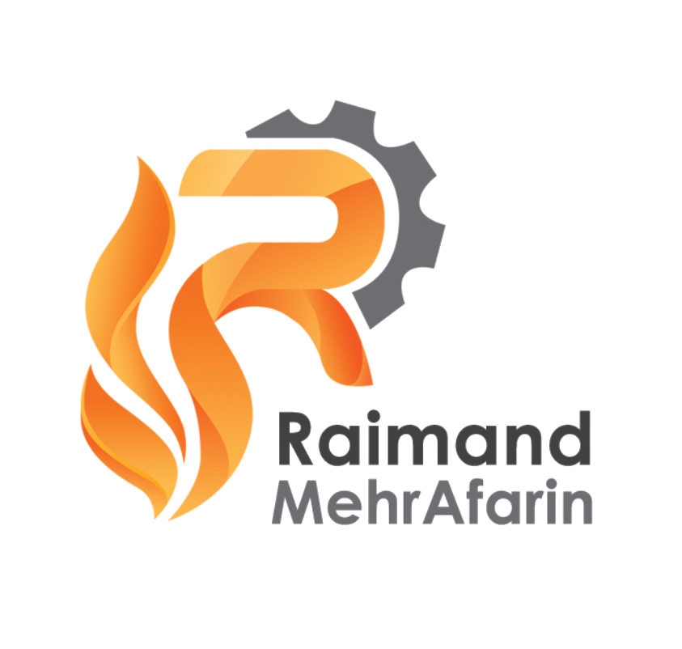
COMPANY PROFILE
Raimand Mehr Afarin Industrial Group Co,
Powering Production, Delivering Excellence

Slide 2
Table Of Content:
Page 3 | Corporate Overview:
Page 4 | Who We Are:
Page 5 | What We Do:
Page 6 | Mission & Vision Statement:
Page 7 | Core Values:
Page 8 | Our Business Areas:
Page 10 | Products & Monthly Supply Capacities:
Page 14 | Quality Assurance:
Page 15 | Our Strengths:
Page 16 | Our Team:
Page 17 | Why Choose Us:
Page 18 | Contact Information:

Slide 3
Corporate Overview:
Raimand MA Industrial Group Co, is a leading producer, processor and global supplier of strategic minerals and metals, serving the metallurgy, foundry, energy and chemical industries. With modern production facilities across key mineral-rich regions of Iran and a strong international export record, we provide consistent quality, reliable supply and long-term value to our global partners.
For more than five years, we have built a reputation for operational excellence and integrity, exporting to major industrial hubs including China, India, UAE, Indonesia, Malaysia, Turkey and Russia. Our vertically integrated operations, from mine sourcing to processing and logistics, enable us to deliver competitive and dependable solutions across our diverse product portfolio.

Slide 4
Who We Are:
We are a multidisciplinary mineral resources company committed to advancing the global supply chain of Chrome, Antimony, Molybdenum, Coal and Ferroalloy materials. With a strong team of industry professionals, modern production plants and long-term partnerships with mines and industrial consumers, we act as a trusted bridge between raw material sources and global end-users.
Our philosophy is simple: quality, reliability and well-planned partnership. We strive to be more than a supplier and our goal is to be a strategic and value-creating partner for every client we serve.

Slide 5
What We Do:
We specialize in the production, processing and international supply of metallic and mineral raw materials essential to steelmaking, alloy production, foundry applications and energy generation.
Our core activities include:
Production of Chrome Concentrate, Foundry Chrome Sands, Antimony Concentrate and Molybdenum Oxide at our dedicated facilities in Iran.
Supply & Trade of Chrome Ore, Antimony Ore, Ferro-Silicon, Copper Concentrate and Steam Coal sourced from reliable mines and partners.
Quality Assurance & Technical Control through continuous monitoring, in-house lab testing and compliance with international industrial standards.
Export & Logistics Management to ensure efficient shipment, timely delivery and regulatory compliance.

Slide 6
Mission & Vision Statement:
Our mission is to deliver high-quality mineral products that empower global industries, while upholding the values of professionalism, transparency and sustainable operation.
We aim to create long-term partnerships by offering dependable supply, competitive pricing, and proactive service tailored to each client's needs.
Our Vision is to be recognized as a globally trusted supplier and producer of strategic industrial minerals, expanding our market presence through continuous innovation, operational excellence and responsible resource management.

Slide 7
Our Core Values:
• Integrity: We conduct every transaction with transparency, fairness and reliability.
• Quality Commitment: Superior product quality and consistent specifications are at the heart of our operations.
• Customer Focus: We build lasting relationships by understanding and serving the real needs of our clients.
• Operational Excellence: Efficient processes, modern facilities and a skilled workforce drive our success.
• Sustainability: We prioritize responsible sourcing, environmental care and community engagement.
• Innovation: We continuously optimize our production technologies and supply chain solutions.

Slide 8
Our Business Areas:
A. Production Facilities
We operate specialized processing plants strategically located near major ore sources:
Chrome Concentrate & Foundry Sand Production Plant
Location: Fariman City, near Mashhad – Northeastern Iran
Molybdenum Oxide (MoO₃) Production Plant
Location: Zanjan Province – Northern Central Iran
These facilities ensure consistent quality, efficient logistics and flexible monthly capacities to meet diverse customer requirements.

Slide 9
Our Business Areas:
B. International Trade & Supply
We maintain long-standing relationships with mines, smelters, foundries and traders across the world, enabling us to supply:
Chrome Ore & Concentrate (Cr 40-44%)
HC Ferrochrome(Cr 62-65%)
Ferro-Silicon (Si 74-75%)
Copper Concentrate (Cu 20-22%)
Steam Coal and Coal Concentrate
Steel Billet & Steel Rebar
Our supply chain expertise guarantees end-to-end reliability—from sourcing and inspection to shipment and documentation.

Slide 10
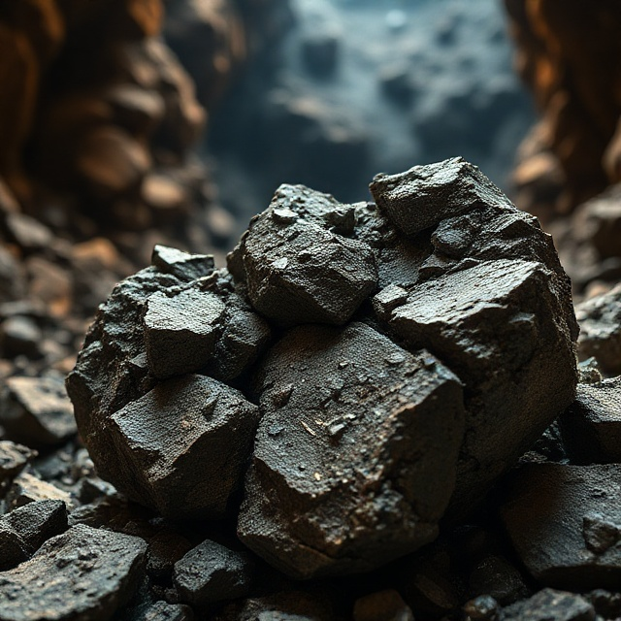
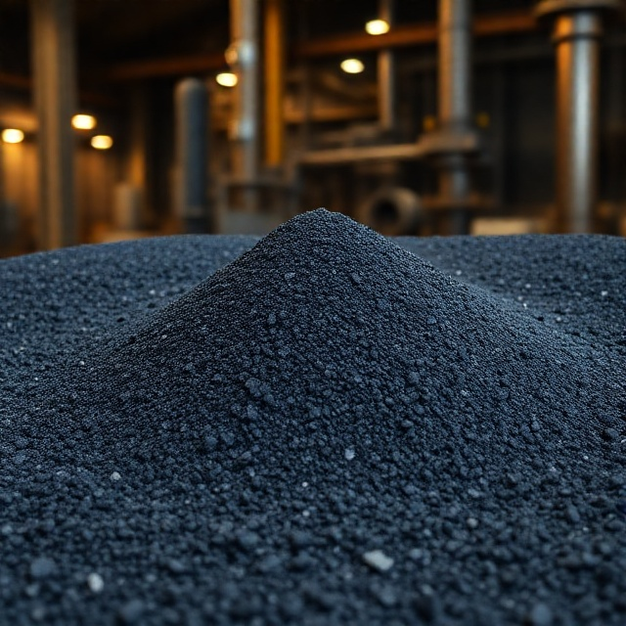
Our Products And Monthly Supply Capacities:
Chrome Ore
Chrome Concentrate
Content: | Grade | Content: | Grade
Cr₂O_{3:} | 40 – 44% | Fe (total) | 8 – 12%
SiO₂: | 6 – 10% | Fe₂O₃: | 12 – 18%
Al₂O₃: | 6 – 9% | Cr/Fe | >2.5
MgO: | 18 – 22% | Mg/Al: | >2.5
Size: |  | 10 – 300 mm
Content: | Grade | Content: | Grade
Cr₂O_{3:} | 42 – 44% | Fe (total) | 10 – 13%
SiO₂: | 6 – 9% | Fe₂O₃: | 14 – 18%
Al₂O₃: | 6 – 10% | Cr/Fe | ≈2.5
MgO: | 17 – 21% | Mg/Al: | ≈2.5
Size: |  | 0 – 1 mm
Packing: Bulk or Big Bags
Supply Capacity: Up to 5,000 MT/Month
Packing: Bulk or Big Bags
Supply Capacity: Up to 1,000 MT/Month

Slide 11
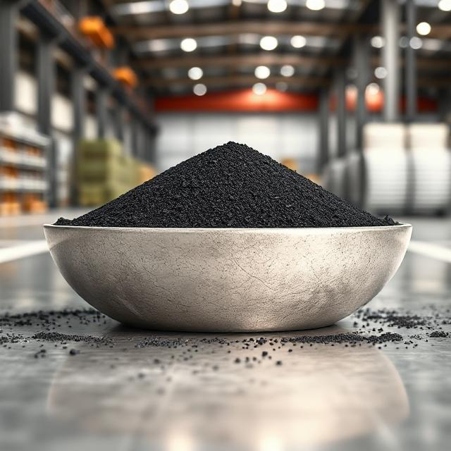
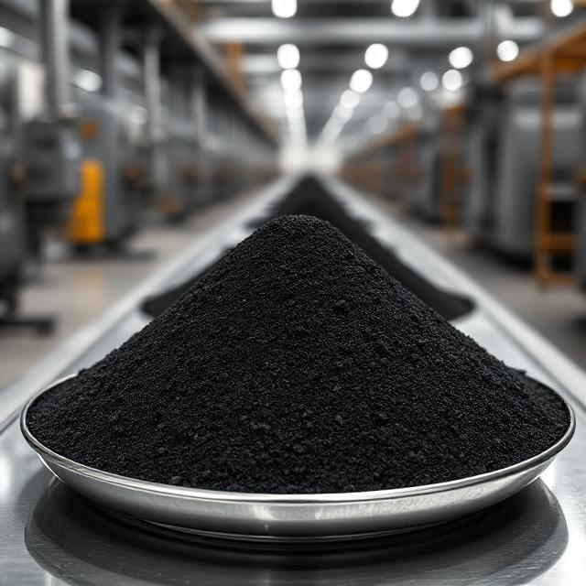
Our Products And Monthly Supply Capacities:
Foundry Chromite Sands (Grade A)
Foundry Chromite Sands (Grade B)
Content: | Grade | Content: | Grade
Cr₂O_{3:} | 50 – 55% | Fe₂O₃: | 20%
Al₂O₃: | 10 – 12% | CaO: | 0.2%
SiO₂: | 1 – 3% | TiO₂: | 0.2%
MgO: | 9 – 11% | LOI: | <1
Content: | Grade | Content: | Grade
Cr₂O_{3:} | 45 – 50% | Fe₂O₃: | 18 - 20%
Al₂O₃: | 10 – 12% | CaO: | 0.1 - 0.4%
SiO₂: | Avg 3% | TiO₂: | 0.1%
MgO: | 14 - 16% | LOI: | <1
Refractoriness | >1730 ⁰C, <2260 ⁰C
Sintering Temp: | >1600 ⁰C
PH Value: | Typ=7, Range= 7-9
Acid Demand @ PH 7: | Typ=0.5, Range= 3cc
Humidity: | Typ 0.01, Max 0.2%
Size: AFS 45-50 / 50-55 / 55-60
Color: Black, Shiny Black
Supply Capacity: Up to 50 MT/M
Refractoriness | >1730 ⁰C, <2180 ⁰C
PH Value: | Typ=8, Range= 7-9
Humidity: | Typ 0.01, Max 0.2%
Size: AFS 45-50 / 50-55 / 55-60
Color: Black, Shiny Black
Supply Capacity: Up to 50 MT/M
Packing: 1 MT Jumbo Bags (Customizable)
Packing: 1 MT Jumbo Bags (Customizable)

Slide 12
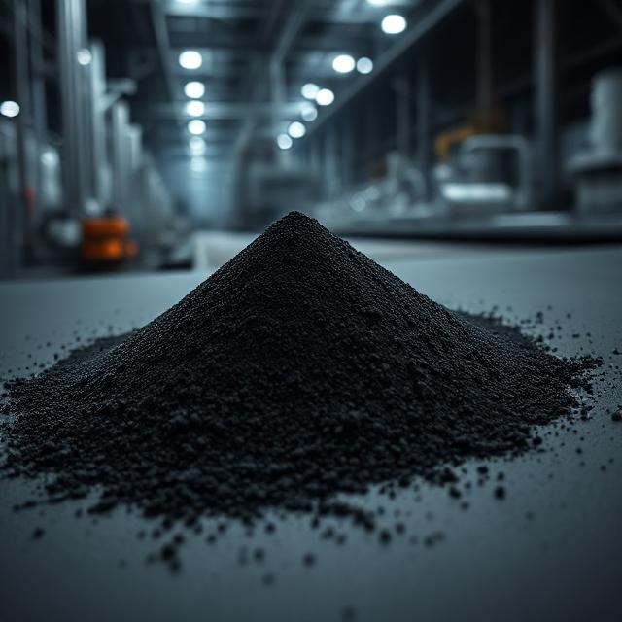
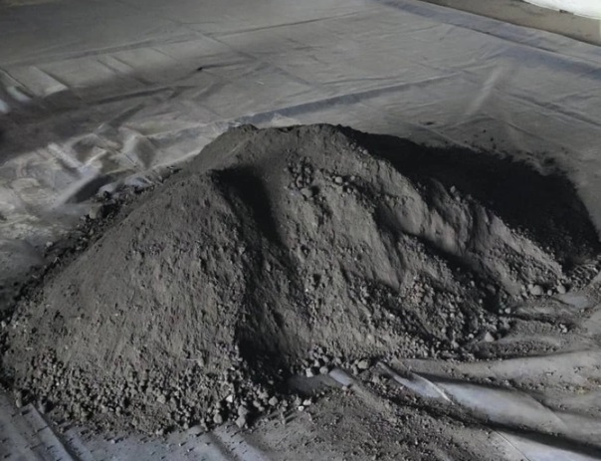
Our Products And Monthly Supply Capacities:
Molybdenum Oxide
Copper Concentrate
Content: | Grade | Content: | Grade
Mo: | 62 – 63% | Pb: | 0.08%
Cu: | 1% Max | C: | <0.08%
S: | 0.15% Max | P: | 0.05% Max
Size: |  | 0 – 6 mm (90% Min)
Content: | Grade | Content: | Grade
Cu: | 20 – 22% | As: | 400 – 500
Pb: | 0.05 – 0.15% | Hg: | <0.1 ppm
Au: | 900 – 1,000 ppm | F: | 7 – 10 ppm
Ag: | 13 – 16 ppm | Cd: | 9 – 10 ppm
S: | 40 – 44% | Size: | 0 – 0.75 mm
Packing: Steel Drums OR 1 MT Big/Jumbo Bags
Monthly Supply Capacity: up to 200 MT/M
Packing: 1 MT Big/Jumbo Bags
Monthly Supply Capacity: up to 500 MT/M

Slide 13
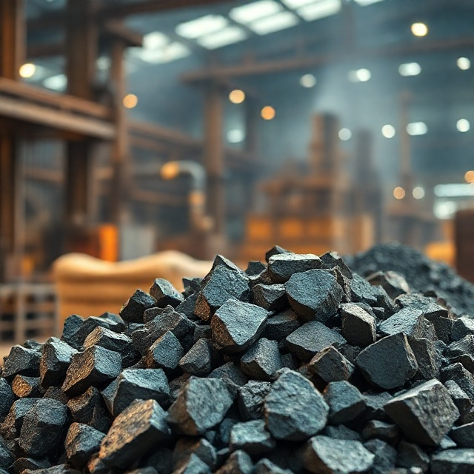
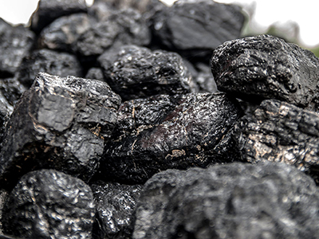
Our Products And Monthly Supply Capacities:
HC Ferrochrome (HC FeCr)
Steam Coal & Concentrate
Content: | Grade
Cr: | 62 – 65%
Si: | <2%
C: | 6 – 8%
S: | <0.07%
P: | <0.03%
Fe Total: | 23 – 26%
Size: | 10 – 60 mm
Content: | Coal | Concentrate
Ash: | 25% | 11%
Total Moisture: | 5% Max | 11% Max
Volatile Mater: | 9 – 17% | 30%
Total Sulphur: | <1% | <1%
Carbon: | Up to 60% | 50 - 55%
Colorific value (Kcal/Kg) | 6000 – 7000 | 7200
Size: | 0 – 150 mm | 3 – 20 mm
Packing: Bulk or Big Bags
Supply Capacity: Up to 500 MT/Month
Monthly Supply Capacity:
Steam Coal: Up to 15,000 MT/M
Coal Concentrate: Up to 10,000 MT/M

Slide 14
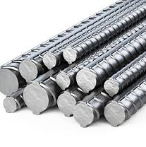
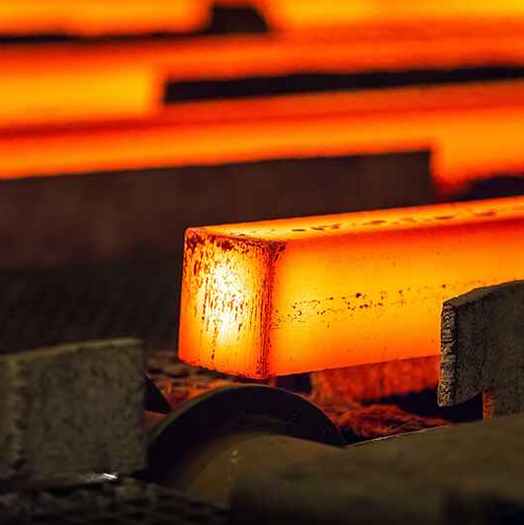
Our Products And Monthly Supply Capacities:
Reinforcement Steel Bars (Rebar)
Steel Billet (3sp)
Chemical Composition:
N: | <60 ppm | S: | 0.021%
Cr: | 0.01% | P: | 0.008%
Ni: | 0.008% | Si: | 0.21%
Cu: | 0.007% | Mn | 0.67%
C.E: | 0.36% | C: | 0.26%
Size: | 130 * 130 (mm*mm)
Length: | 12 M
Product Type: A3 (A400) rebar (14–28 mm)
Monthly Supply Capacity: up to 3,000 MT/M
Monthly Supply Capacity: up to 10,000 MT/M

Slide 15
Quality Assurance:
To guarantee product consistency and customer satisfaction, our quality management system includes:
In-house sampling and laboratory testing.
Strict adherence to customer specifications.
Batch-by-batch inspection and certification.
Continuous monitoring of moisture, purity, chemical composition and particle size distribution.
Compliance with international export standards and safety regulations.

Slide 16
Our Strengths:
Strategic Locations ensuring efficient logistics and proximity to major mines.
Integrated Operations from production to export documentation.
Flexible Capacity to meet both spot and long-term contract requirements.
Diversified Product Portfolio covering multiple industrial sectors.
Experienced Management with regional and international commodity expertise.
Stable Export Record across Asia, the Middle East and Europe.

Slide 17
Our Team:
Our team is composed of experienced engineers, metallurgists, chemists, production managers, commercial experts and logistics specialists. Together, we ensure:
Reliable and efficient plant operations
Accurate quality control
Professional communication with clients
On-time execution of contracts and shipments
We believe strong teamwork is the foundation of our performance and customer satisfaction.

Slide 18
Why Chose Us:
Consistent and reliable monthly supply
Competitive and transparent pricing
Strong logistics and export capability
Proven track record with global industrial clients
Commitment to long-term partnerships
Fast response and customer-centric approach

Slide 19





Contact Information:
Raimand Mehr Afarin Industrial Group Co,
Powering Production, Delivering Excellence
Unit 1, No 57, Reza 6, Reza Blvd, Ahmad Abad Blvd, Mashhad, Iran
+98-51 3840 9224
+98-938 380 2555
www.raimandma.com
sales@raimandma.com
ms.raimandma@gmail.com

Slide 20
Raimand Mehr Afarin Industrial Group Co,
Your Trusted Business Partner
Thank you

